Slide 1

Borqs SmartAT Server
Notes:
1
主标题 字号：37 （加粗）字体：Arial颜色：RGB：51 51 153
日期 字号：30 字体：Arial颜色：RGB：51 51 153

Slide 2
Summary
Functions:
store and manage test result, provide test report/statistics
Features
  Account management
  Project/Product management
  Test session and test case result management
  Test cycle management
  Test report calculation and presentation
Notes:
1

Slide 3
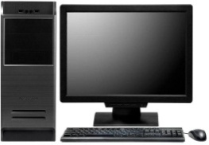
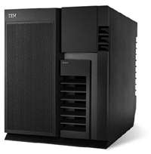


Overview Layout
App Server
(Memcached Server)
Mongodb Server
Test Machine
Proxy Server
LAN
http
LAN
Redis Server
Http (https)
Worker Server
Test Machine
http
Web Server
Access result from Browser
Notes:
1

Slide 4
Overview Architecture - FrontEnd
Login Page
Index Page
Login
Account Info
inGroup List
inTest List
New Account
Group Page
Update Account
Session List in group
Session Detailed Info
Group Member Manage
Notes:
1

Slide 5
Overview Architecture - BackEnd
SmartServer
/smartapi (listen on 8081)
/smartserver (listen on 8080)
account
Test
Group
Static files indexing
Business impl
Account Module
Group Module
Test Module
SmartWorker
Dbstore
Mongodb Driver
Redis
Driver
Memcached Driver
Notes:
1

Slide 6

Notes:
1

